Slide 1
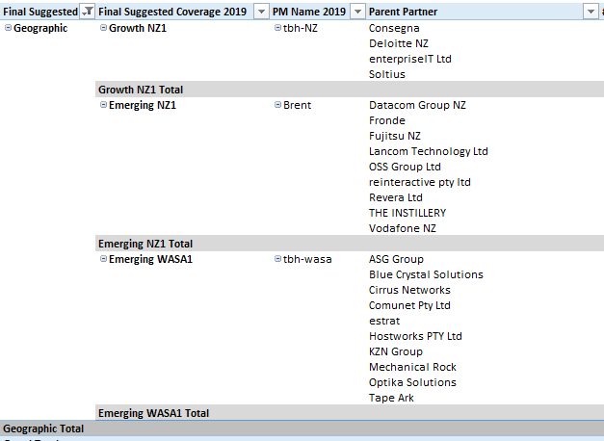
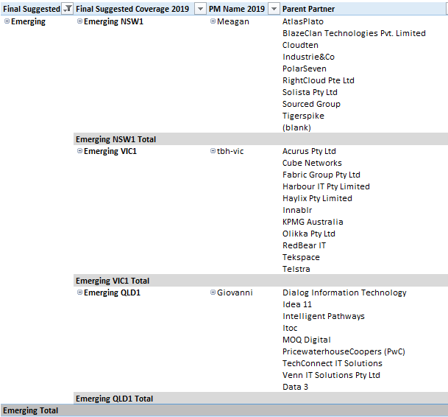
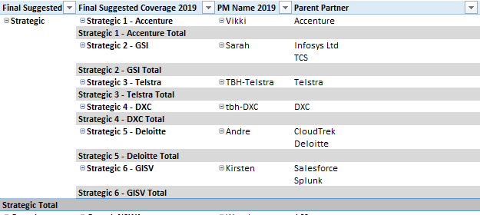
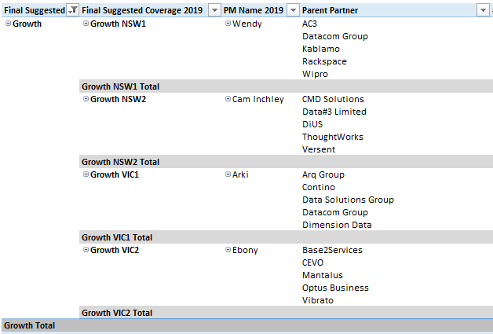
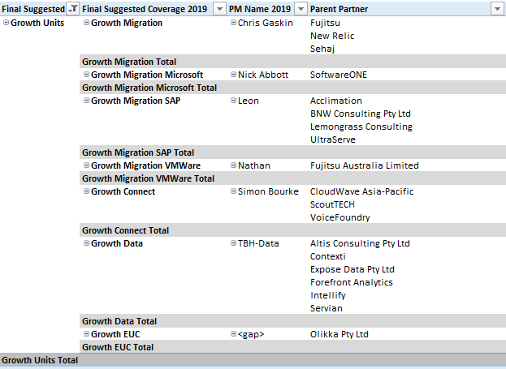
Partner – 2019 Structure per MDU
Geographic Partners
Strategic Partners
Emerging Partners
Growth Partners
Growth Units and Tactical Partners
© 2018, Amazon Web Services, Inc. or its Affiliates. All rights reserved
Notes:
Plan A (Full) 54 HC

